Slide 1
Andréanne Baillargeon
Marie-Pier Caron
Grade 3
Topic: weather
The aim: This activity is a review that could be used during period 2. It is a warm up to see if students remember vocabulary about the weather.
Procedure: In small groups, students first hear the sound then they have to consult their team members to write the word without any spelling mistakes. Then, a spoke person raises his hand to give the answer. After, the teacher shows the illustrations and gives a point to teams who have correct answers.

Slide 2
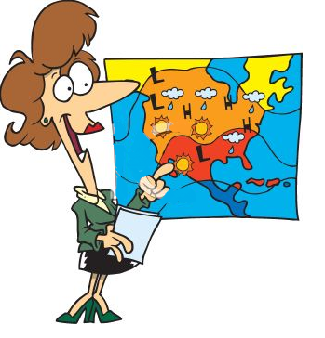
Weather

Slide 4
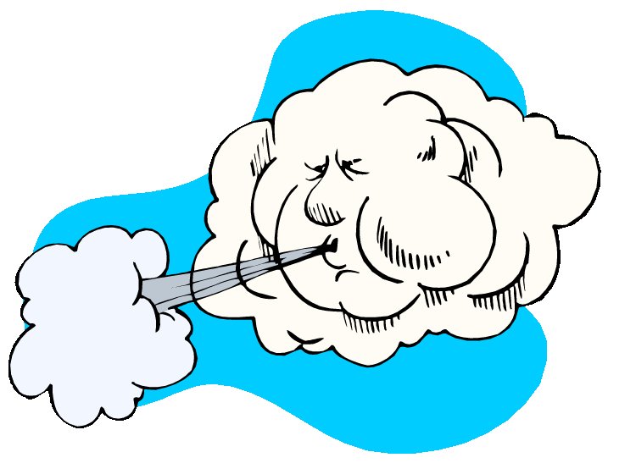
Windy

Slide 6
Sunny

Slide 8
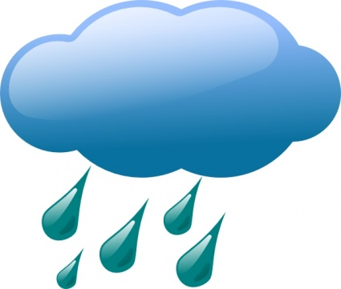
Rainy

Slide 10
Snowy

Slide 12
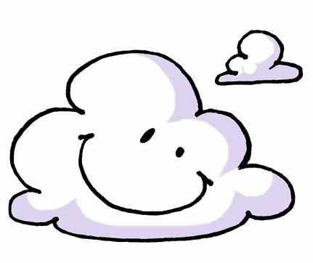
Cloudy

Slide 14
Thunder

Slide 16
Lightning

Slide 17
Congratulations

